Slide 1
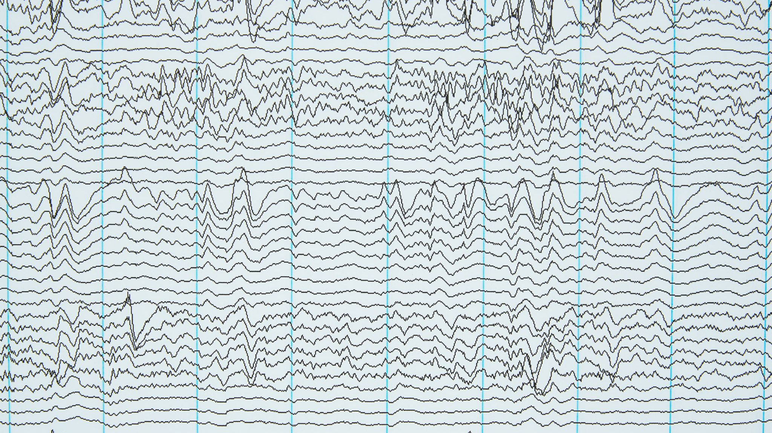
Resting state EEG alpha waves power extraction and calculations of 1/slope using FOOOF library
Prepared by Donata Bagdonavičiūtė

Slide 2
Main steps
Create a table of participants individual information (age, weight, height, BMI) used in experiment.
Obtaining and comparing alpha waves power parameters between participants graphically and store information in tables.
Obtaining 1/f offset values in graphs and in excel files.
Notes:
Resting state EEG data after emotional task will be analyzed using FOOOF library. During analysis the main objects will be alpha waves, power spectral density and 1/f slope differences between two participants. The goal of project is analyze the available data and create the environment to analyze data for Master thesis.

Slide 3
What kind of libraries was used?
pandas
numpy
scipy
fooof
matplotlib
seaborn
mne
Notes:
Some participants are missing due to broad artefacts in EEG data.

Slide 4
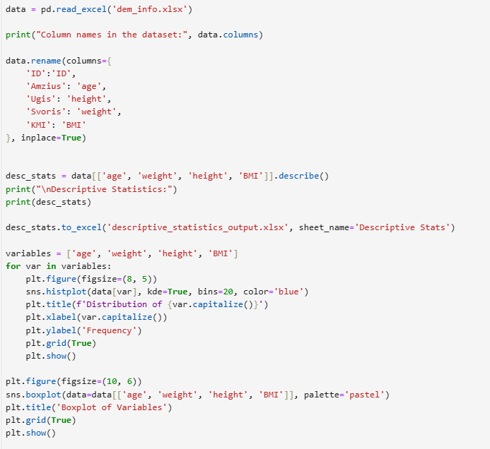
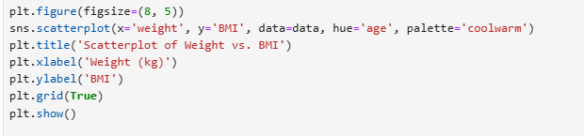
Handling participants information
Notes:
The inplace=True ensures the changes are applied directly to the data variable.
data[['age', 'weight', 'height', 'BMI']]: This selects specific columns from the dataset.
.describe(): It calculates summary statistics for these columns:
Count (number of values)
Mean (average)
Standard deviation (how spread out the values are)
Min, Max, and Percentiles (like 25%, 50%, 75% of the values).
You also print these statistics to see the summary.
This saves the summary statistics into a new Excel file called descriptive_statistics_output.xlsx.The sheet name in the file will be Descriptive Stats
Goal: This creates a histogram for each variable (age, weight, height, and BMI).
A histogram shows how frequently different values appear (e.g., how many people weigh 60kg, 70kg, etc.).
sns.histplot(): Makes the histogram and adds a smooth curve (kde=True).
plt.figure(): Adjusts the size of the chart.
plt.title, plt.xlabel, plt.ylabel: Add labels to the chart to make it readable.
plt.show(): Displays the chart.
This loop repeats for all 4 variables.

Slide 5
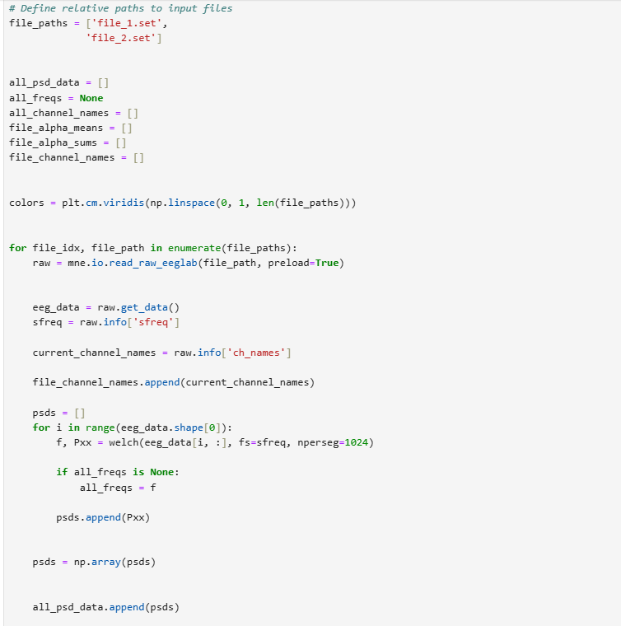
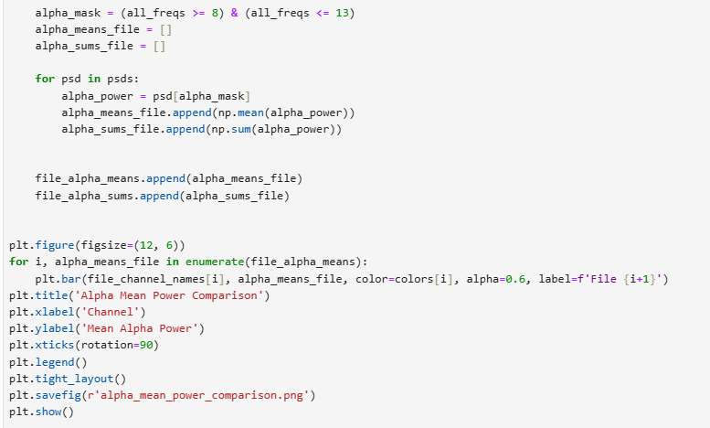
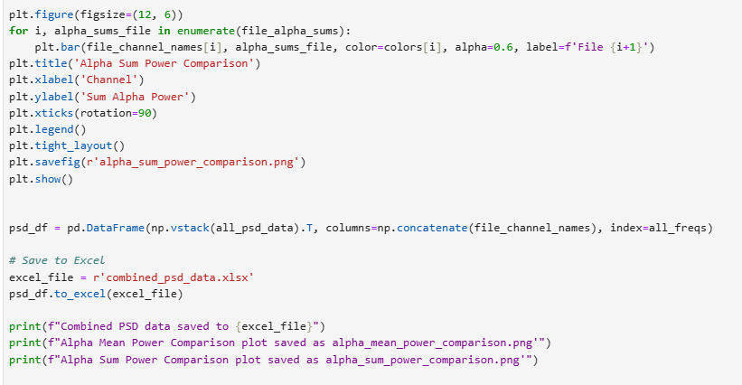
Alpha power extraction from .set files and comparison between two participants
Notes:
all_psd_data: To store PSD values for all files.
all_freqs: To store the frequency values corresponding to the PSD (initialized as None until we get data).
file_alpha_means & file_alpha_sums: To store alpha power stats (mean and sum) for each file.
file_channel_names: To store the names of EEG channels for each file.
colors: A color map to assign unique colors to the bar plots for different files.
This loop processes each file in file_paths.mne.io.read_raw_eeglab(): Reads the EEG file in .set format. The preload=True argument loads the data into memory for analysis.
raw.get_data(): Retrieves the EEG data as a 2D array where:Rows = channels.
Columns = time points (signal values at each time).
raw.info['sfreq']: Sampling frequency of the EEG recording (how many data points per second).raw.info['ch_names']: Names of the EEG channels (e.g., Fz, Cz, etc.).Add the channel names for the current file to the file_channel_names list.
For each channel in the EEG data:
welch() computes the power spectral density (PSD) for the channel:
f: Frequencies.
Pxx: Power values at each frequency.
Save the frequencies (f) only once (the first time) in all_freqs.
Append the PSD values for each channel to psds.
all_psd_data.append(psds): Add the PSD values for this file to the overall data.
Alpha Band: A specific frequency range (8-13 Hz) in brainwave signals linked to relaxation.alpha_mask: Identifies the frequencies in the alpha band.For each channel:psd[alpha_mask]: Extracts the PSD values within the alpha band.
np.mean(): Calculates the average alpha power.
np.sum(): Calculates the total alpha power.
Save these values for each file.
np.vstack(all_psd_data).T: Combines PSD data from all files into a single table.pd.DataFrame(): Converts the data into a table format:Columns = EEG channels.
Index = Frequencies.
Save this table to an Excel file called combined_psd_data.xlsx

Slide 6
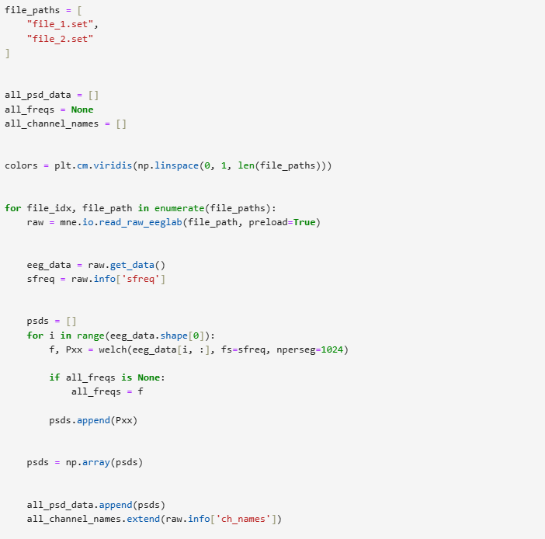
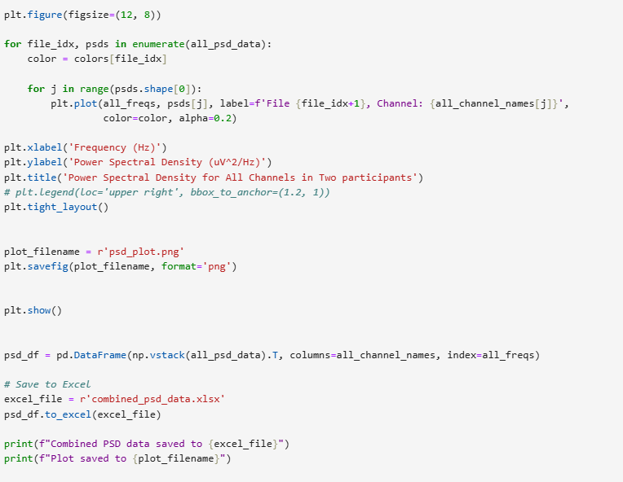
PSD extraction
Notes:
all_psd_data: Will store the PSD data for all files.all_freqs: Will store the frequency values corresponding to the PSD (initialized as None).all_channel_names: Will store the names of EEG channels across all files.colors: Assigns unique colors to each file for plotting, using a colormap (viridis).
raw.get_data(): Retrieves the EEG data as a 2D array where:Rows = channels.
Columns = time points (signal values at each time point).
raw.info['sfreq']: Gets the sampling frequency of the EEG recording (how many data points per second).
For each channel in the EEG data:welch() computes the power spectral density (PSD):
f: Frequencies.
Pxx: Power values at each frequency.
Save the frequencies (f) only once (the first time) in all_freqs.
Append the PSD values for the channel to the list psds.
Convert the PSD list into a NumPy array for easier manipulation.Add the PSD values for the current file to all_psd_data.Add the channel names for this file to all_channel_names.
Creates a plot to visualize the PSD for all channels in all files.Outer loop: Iterates over each file’s PSD data.Inner loop: Iterates over each channel within the file.plt.plot(): Plots the PSD curve for each channel:all_freqs: X-axis (frequency values).
psds[j]: Y-axis (PSD values for the channel).
color=color: Assigns a unique color to each file.
alpha=0.2: Makes the lines semi-transparent for better visualization.

Slide 7
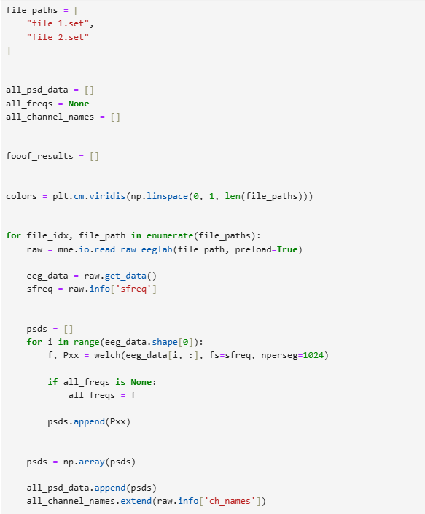
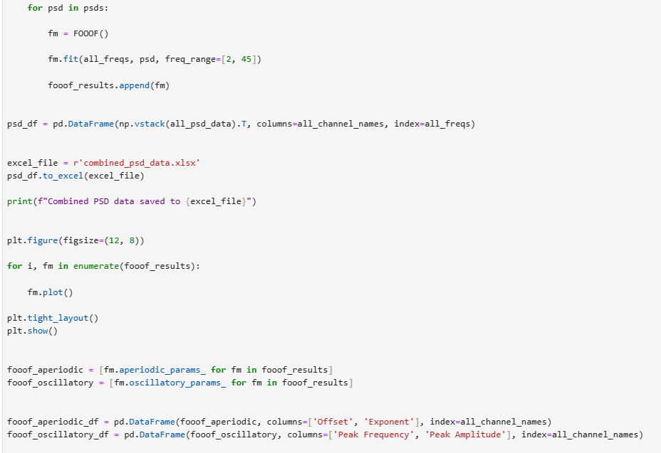
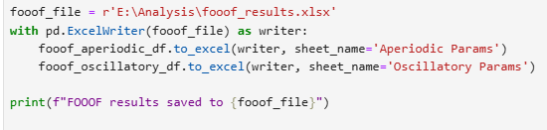
1/f slope calculation in every channel

Slide 8
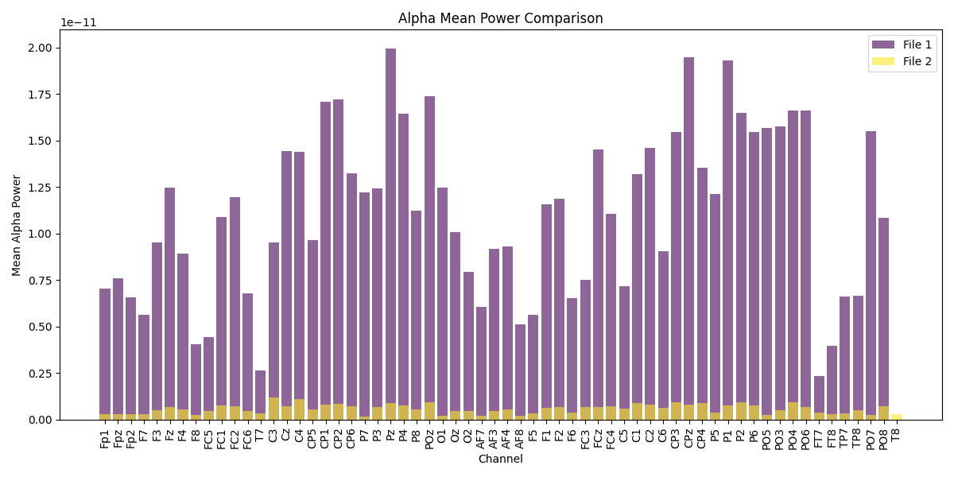
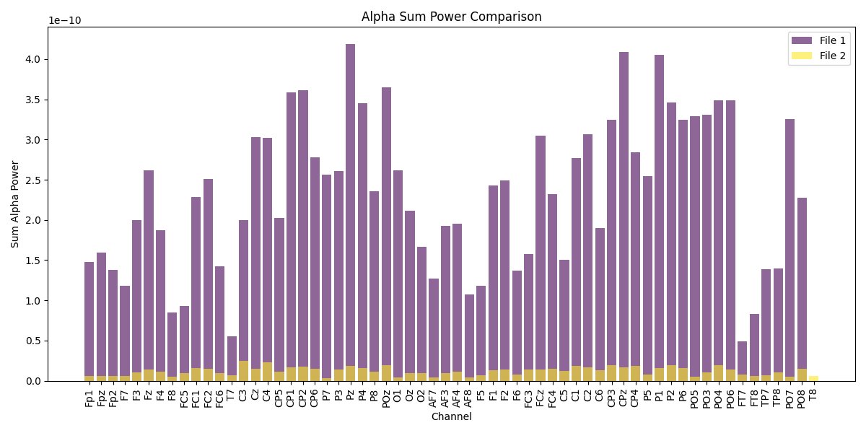
Results

Slide 9
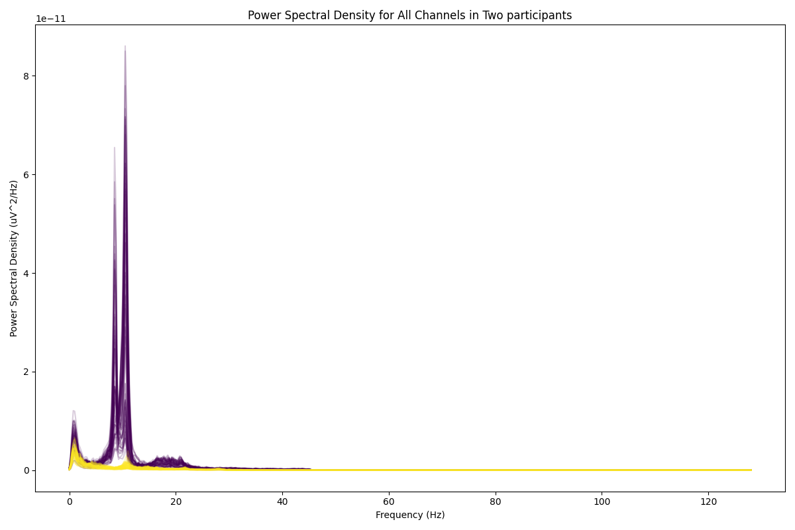
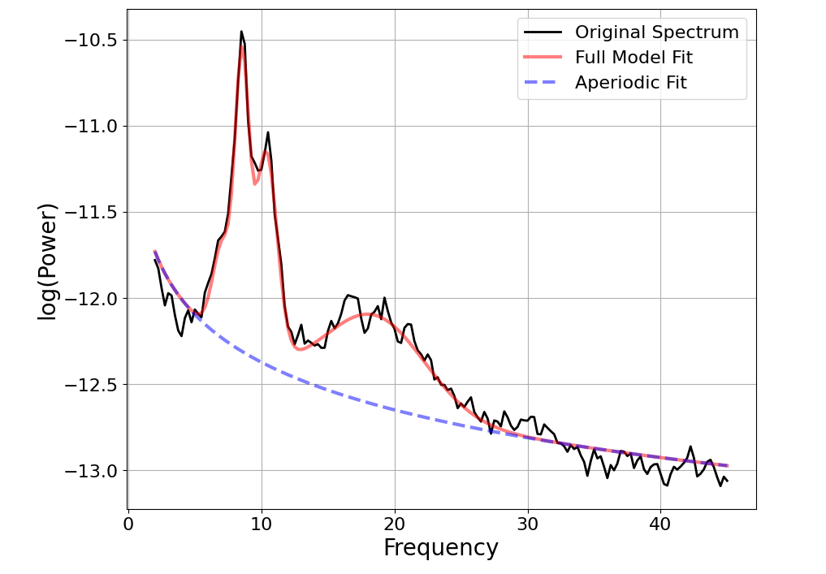
Results

